Slide 1
Project ID: HS-GEOC-131
Exploring Innovative Machine Learning Models for Soil CO₂ Emission Forecasting

Slide 2
Introduction
Issue Statement
Currently, the world is experiencing global warming because of large amounts of CO2 emissions. A large contributor to this is a natural process called soil respiration by which CO2 is released from the soil. Despite its significance, accurately predicting CO₂ emissions caused by soil respiration remains challenging, and the influence of environmental variables are not fully understood.
Previous works
Early studies using AI to predict soil respirations often rely on linear models or oversimplified datasets which lacked real-world applications.
Research Objectives
Accurately predict CO₂ emissions from soil respiration based on spatial, temporal, climatic, and other observable variables by machine learning models.
Provide model explainability to understand the environmental drivers behind soil respiration process.

Slide 3
Methodology - Data
Data source
All data is taken from Soil Respiration Database Version 5
(SRDB-V5), a comprehensive global archive of published research data on soil respiration.
Data cleaning and preprocessing
Records with entries flagged in the Quality_flag field were excluded from the analysis.
Extreme outliers, with Rs_annual values above 5000 gCm⁻², were also removed; this corresponded to 22 records from a total of 12,272 entries (less than 0.2%).
Missing values for the independent variables were replaced by the median value of each respective feature.

Slide 4
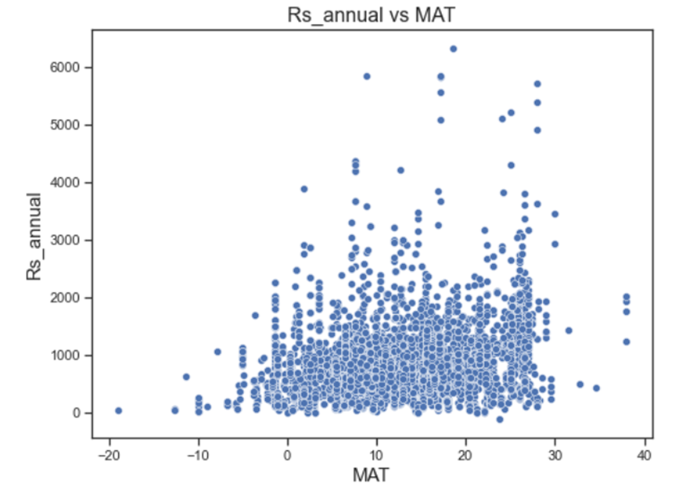
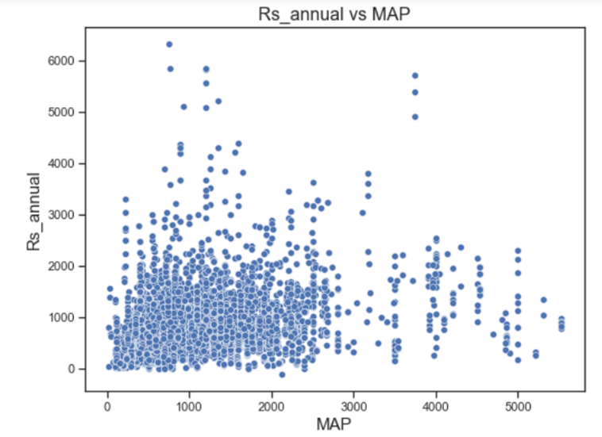
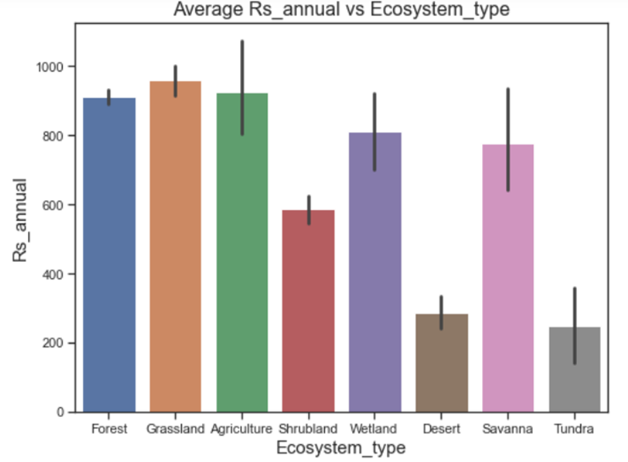
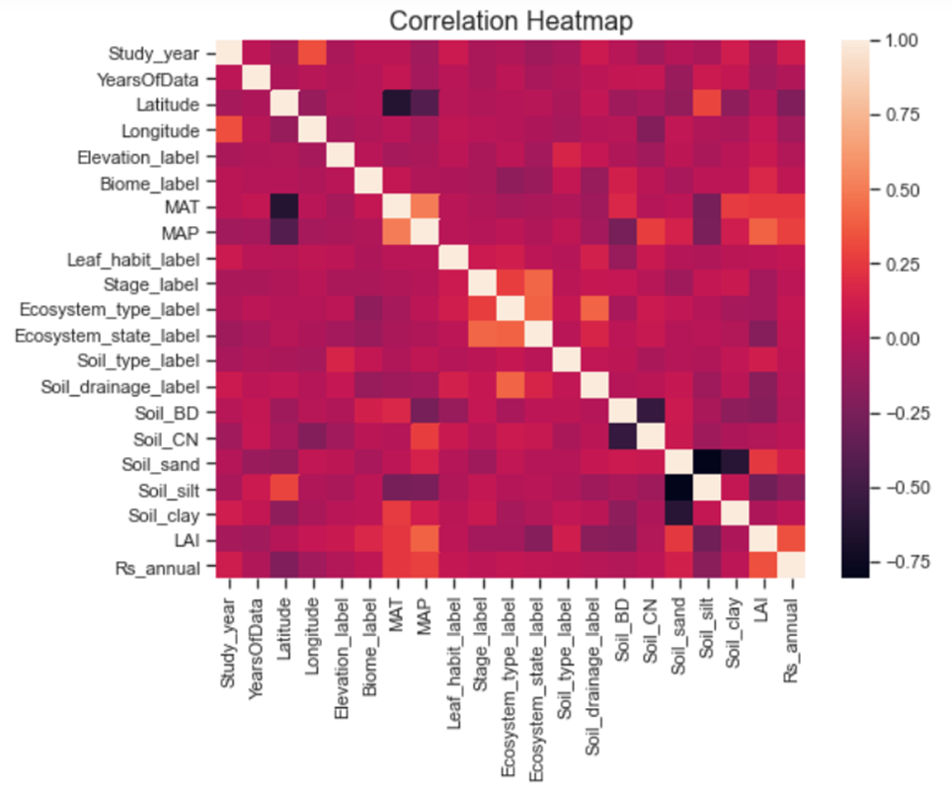
Methodology - Exploratory Data Analysis
Dependent variable: Rs_annual, the quantity of carbon dioxide emitted in a year by soil respiration.
Independent variables (total 29):
Spatial/temporal: Study_year, YearsOfData, Latitude, Longitude, Biome, Elevation
Climate: MAT, MAP
Land use: Ecosystem_type, Ecosystem_state
Soil: Soil type, soil drainage, density etc.
Vegetation and carbon features: LAI, total carbon in vegetation at site, basal area at site etc..
All plots were generated by author

Slide 5
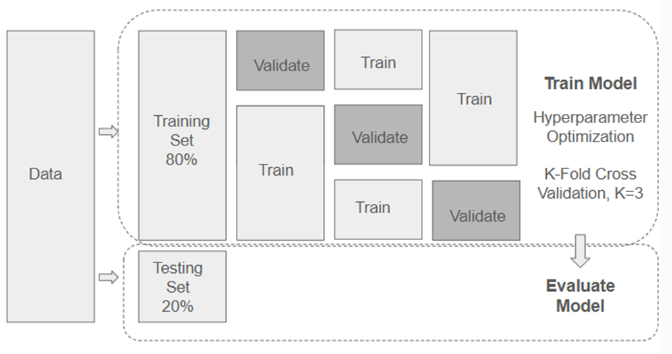
Methodology - Model Training
Model selection
Proposed Model: XGBoost
Baseline Models: Random Forest (RF), Gradient Boosting (GB)
Model explored: DNN model
Hyperparameter optimization
GridSearchCV with K-fold cross-validation.
XGBoost parameters: number of estimators, tree depth, and learning rate …
DNN: neuron counts, learning rate, and batch size…
All plots were generated by author

Slide 6
Methodology - Model Evaluation
Evaluation Metrics
Mean Absolute Error (MAE): Average absolute difference between predicted and real observed values
Root Mean Squared Error (RMSE): Square root of the mean of the squared differences between the predicted and actual values.
Coefficient of Determination (R²): The amount of variance in the dependent variable that can be explained by the independent variables in the regression model.

Slide 7
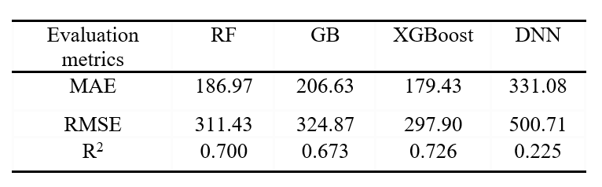
Results - Model Performance Comparison
XGBoost model has the best performance in terms of predictive accuracy and error reduction compared with the other three models with lowest MAE and RMSE, and highest R2.
The DNN model does not provide good results due to small sample size.

Slide 8
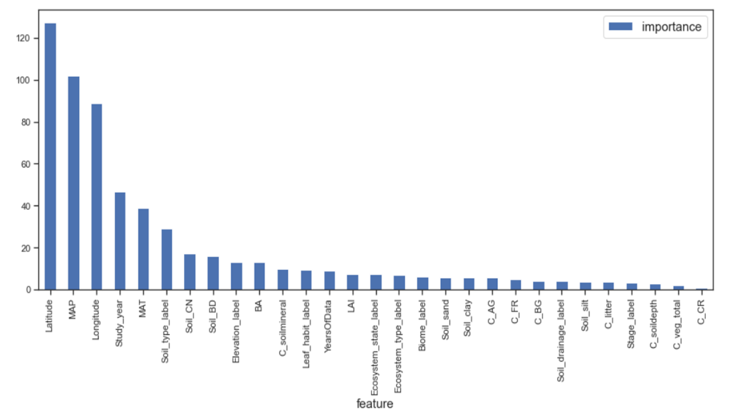
Results - Model Explainability by SHAP Analysis
Machine learning methods are mostly seen as "black boxes." To overcome this, SHapley Additive exPlanations (SHAP) is applied together with the XGBoost model to analyze feature importance, feature distribution, partial dependence, and the interactions between different features.
Feature Importance Plot
Mean Annual Temperature (MAT) and Mean Annual Precipitation (MAP) are the most influential environmental factors, alongside geographic features such as latitude and longitude, aligning with previous studies.
In addition, the four features, Study Year, Soil Type, soil composition related features, Elevation, and Basal Area (BA) also demonstrate high impact on Rs estimates.
All plots were generated by author

Slide 9
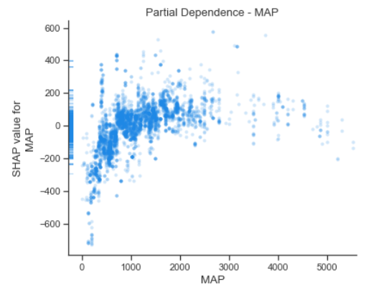
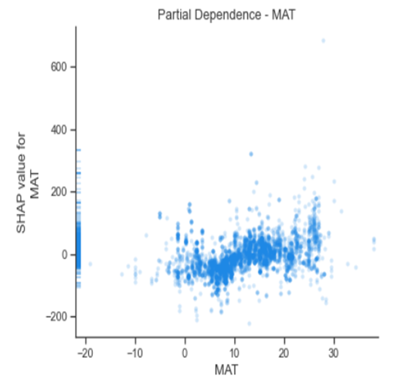
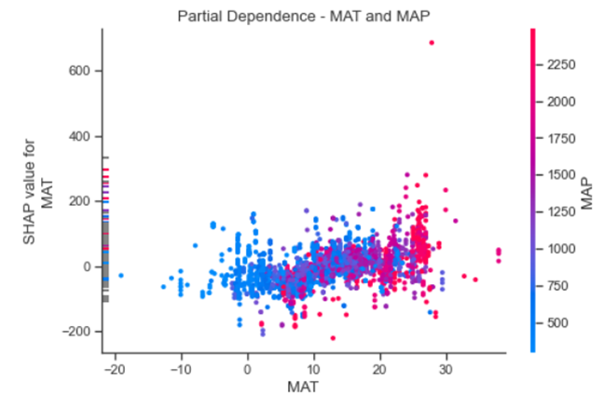
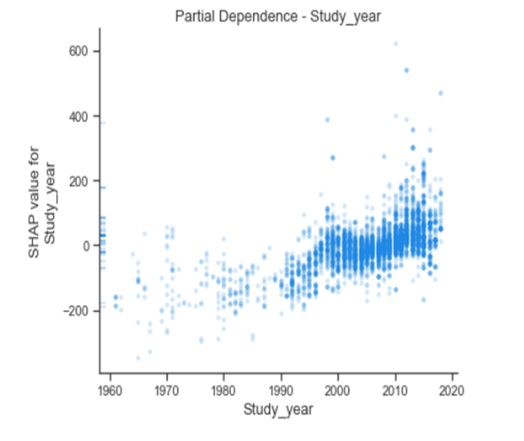
Partial dependence plots from SHAP illustrate how the model outcome changes as a specific feature change, while other features remain unchanged.
As MAP increases up to 1000 mm, Rs increases. However, beyond 1000 mm of MAP, the predicted Rs values level off.
A slight upward trend between MAT and Rs.
Interaction effect of MAT and MAP
A clear upward trend between study year and predicted Rs
All plots were generated by author

Slide 10
Conclusion
An innovative ensemble model, XGBoost, is developed to predict annual Rs from spatial, temporal, climate, and other independent variables. In addition, a DNN model is experimented. The models are evaluated against two baseline models, Random Forest (RF) and Gradient Boosting (GB) from previous studies.
The XGBoost model delivers the best performance, achieving a 4% reduction in MAE and RMSE and a 3.7% improvement in R² compared to the Random Forest model, previously identified as the top-performing approach.
The DNN model fails to achieve reasonable results, primarily due to the limited sample size.
SHAP analysis is a great tool to provide model explainability, highlighting the importance of the impacts of features on predictions provided by the model.
Results reveal that Mean Annual Temperature (MAT) and Mean Annual Precipitation (MAP) are the most influential environmental factors, alongside geographic features such as latitude and longitude, aligning with previous research.
In addition, the four features, Study Year, Soil Type, soil composition related features, Elevation, and Basal Area (BA) also demonstrate high impact on Rs estimates.

Slide 11
References
D. M. Lawrence et al., "The Community Land Model version 5: Description of new features, benchmarking, and impact of forcing uncertainty," J. Adv. Model. Earth Syst., vol. 11, no. 12, pp. 4245–4287, 2019.
J. Liu, J. Hu, H. Liu, et al., "Global soil respiration estimation based on ecological big data and machine learning model," Sci. Rep., vol. 14, 13231, 2024. doi: 10.1038/s41598-024-64235-w.
H. Lu, S. Li, M. Ma, et al., "Comparing machine learning-derived global estimates of soil respiration and its components with those from terrestrial ecosystem models," Environ. Res. Lett., vol. 16, no. 5, Art. 054048, 2021. doi: 10.1088/1748-9326/abf526.
H. Luo, C. Xiang, L. Zeng, et al., "SHAP-based predictive modeling for 1-year all-cause readmission risk in elderly heart failure patients: Feature selection and model interpretation," Sci. Rep., vol. 14, 17728, 2024. doi: 10.1038/s41598-024-67844-7.
AI was not used in creating this display item

